Slide 1
Sarah’s Documentation

Slide 2
Goals

Slide 3
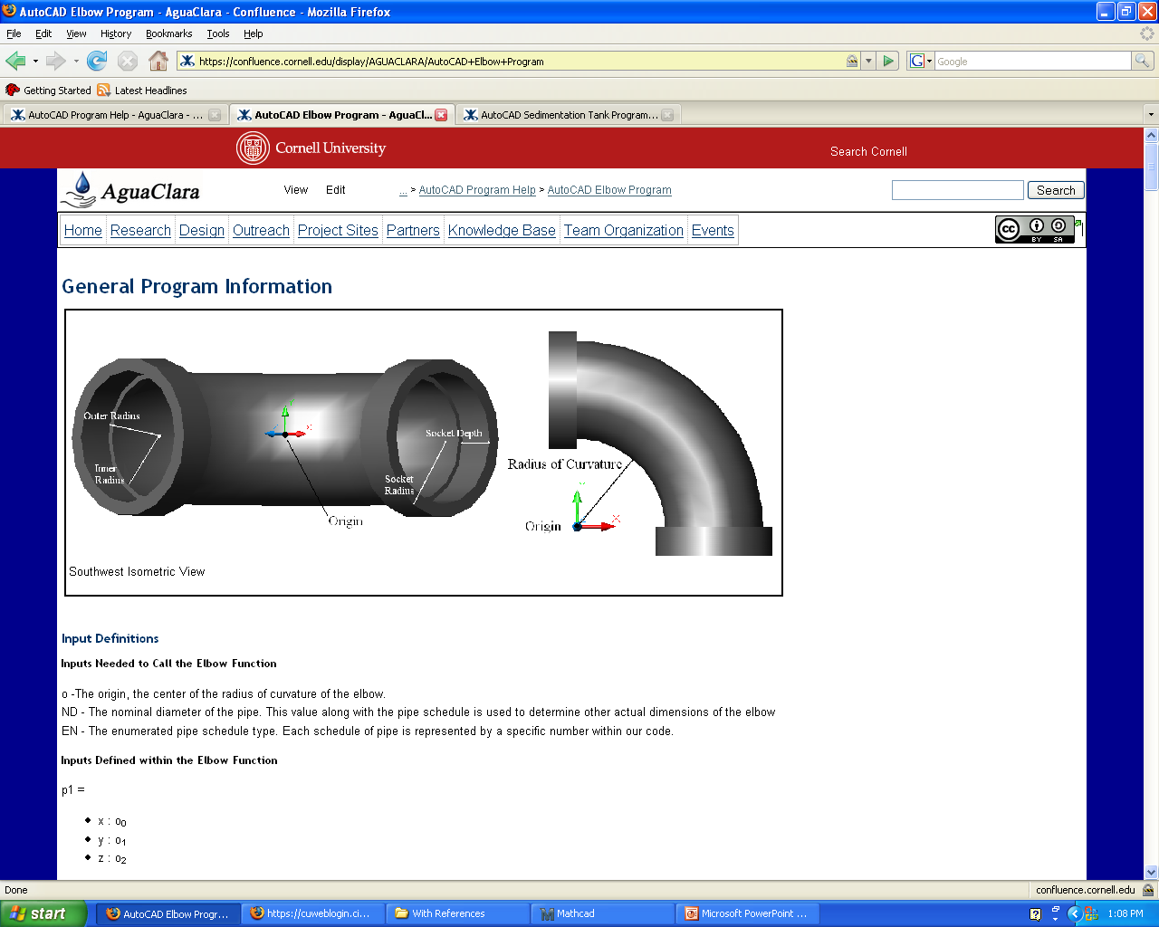
Elbow

Slide 4
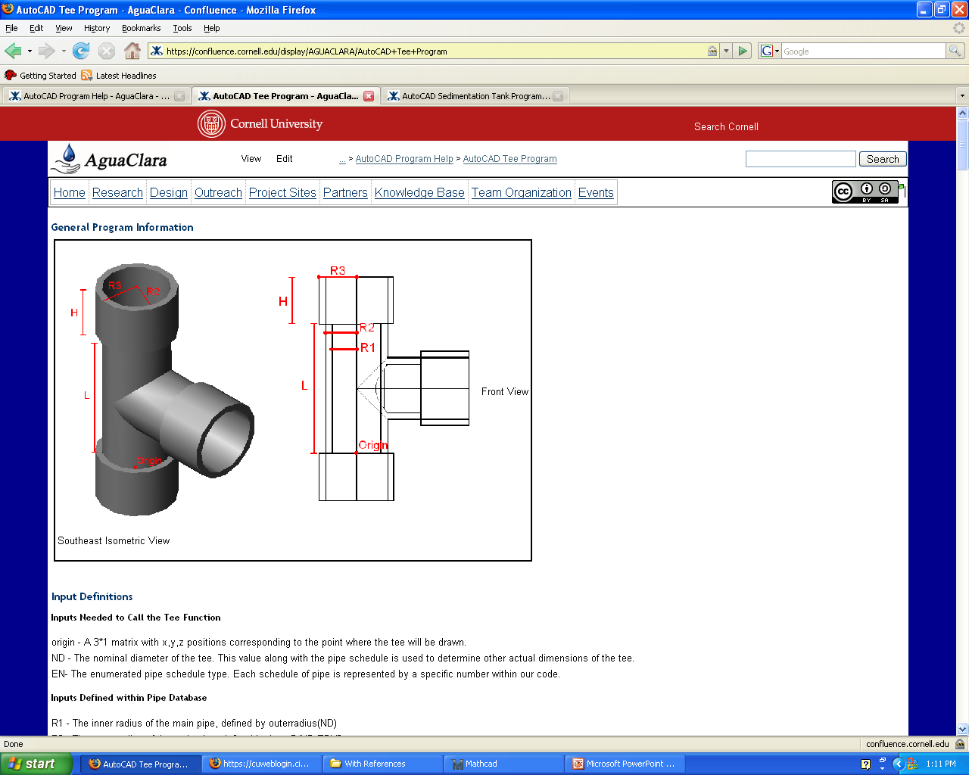
Tee

Slide 5
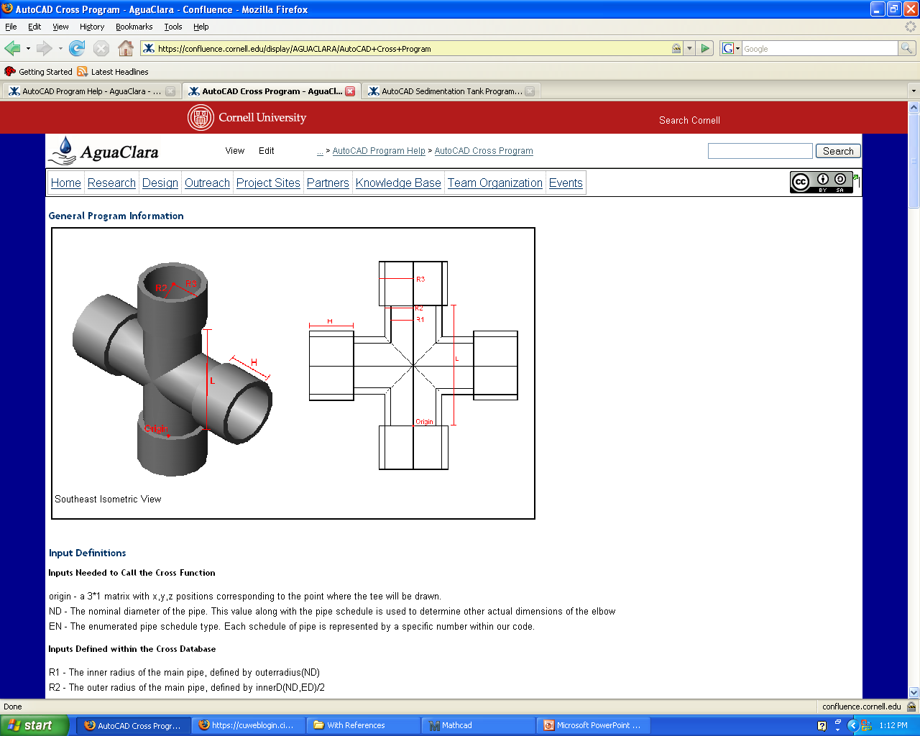
Cross

Slide 6
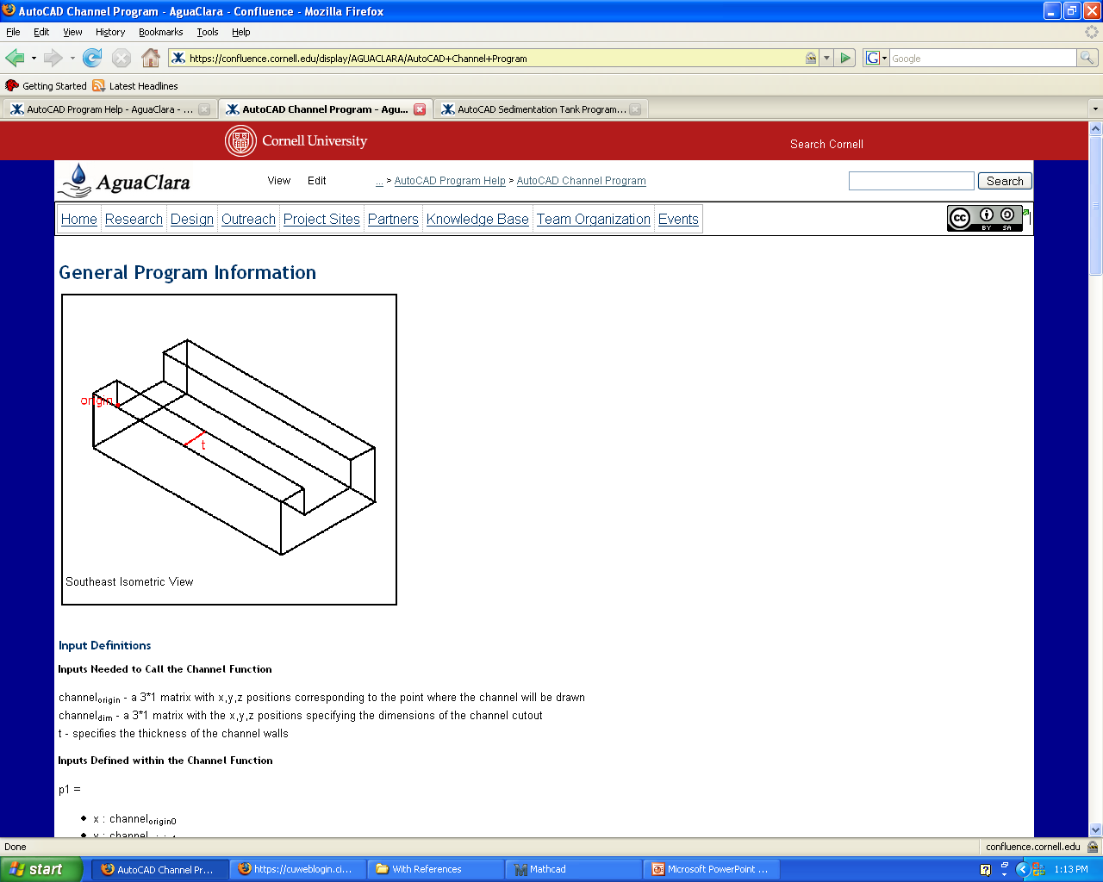
Channel

Slide 7
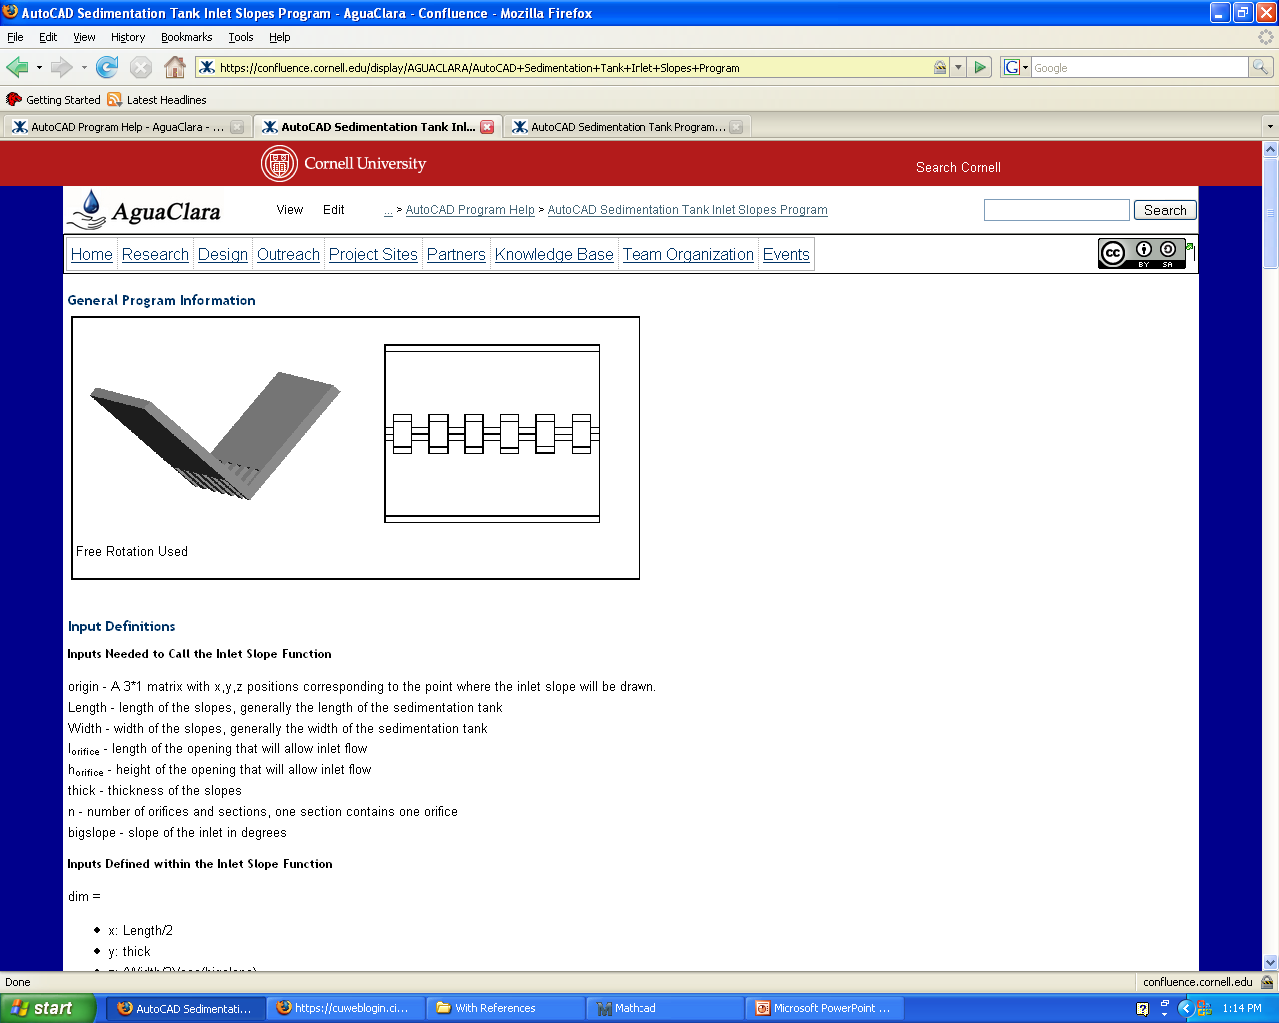
Sedimentation Tank Inlet Slopes

Slide 8
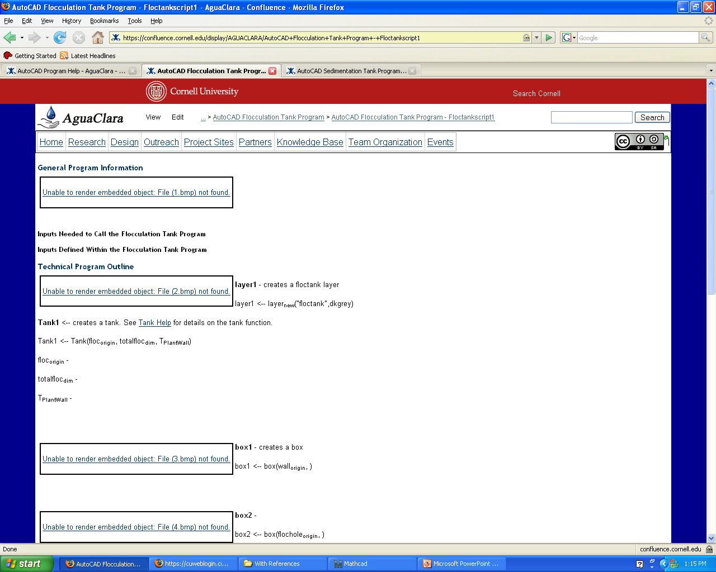
Flocculation Tank - Floctankscript1

Slide 9
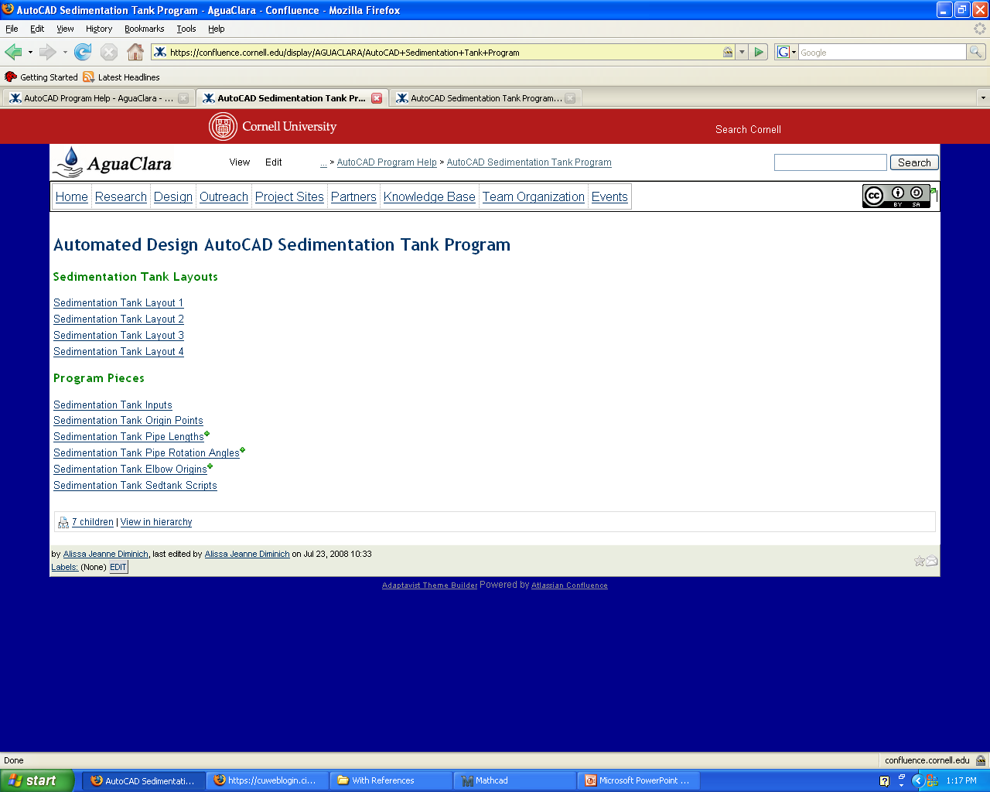
Sedimentation Tank

Slide 10
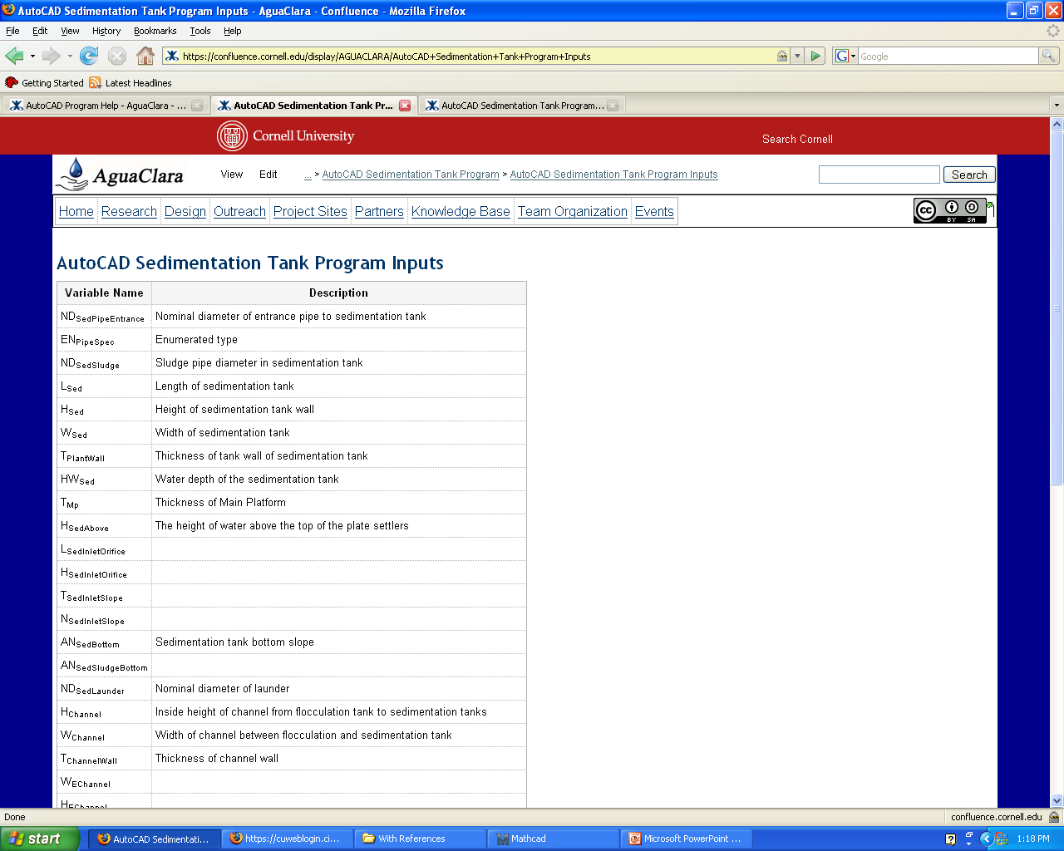
Sedimentation Tank - Inputs

Slide 11
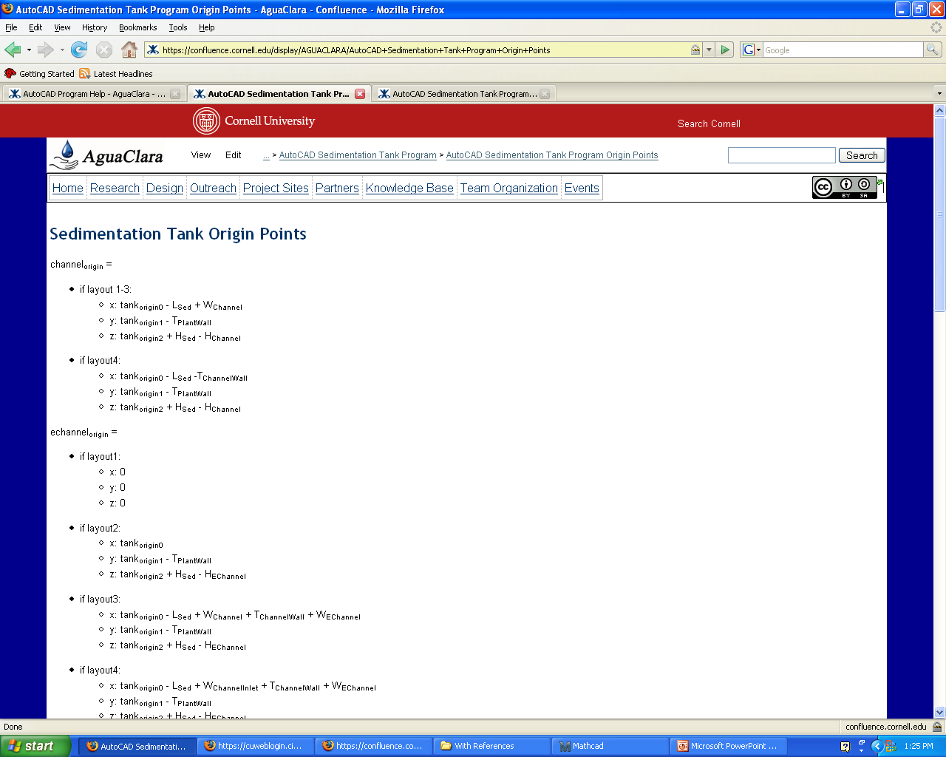
Sedimentation Tank – Origin Points

Slide 12
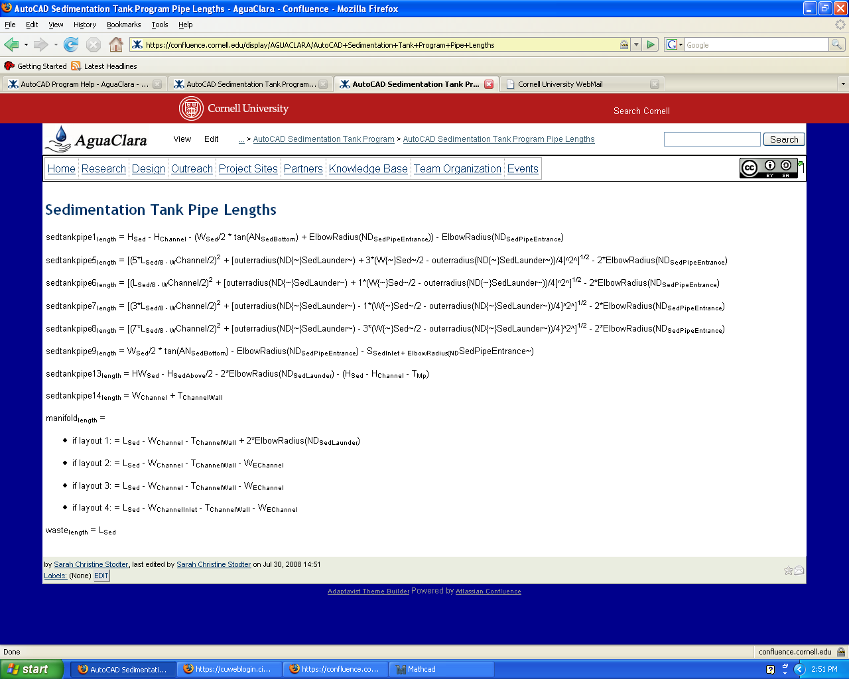
Sedimentation Tank – Pipe Lengths

Slide 13
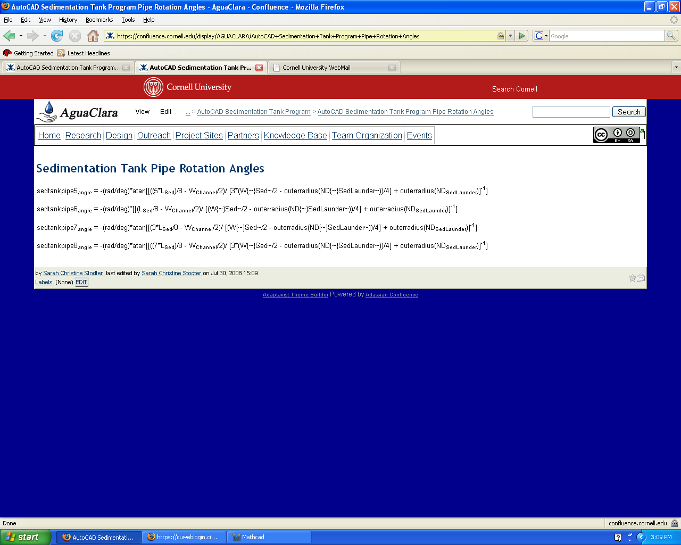
Sedimentation Tank – Pipe Rotation Angles

Slide 14
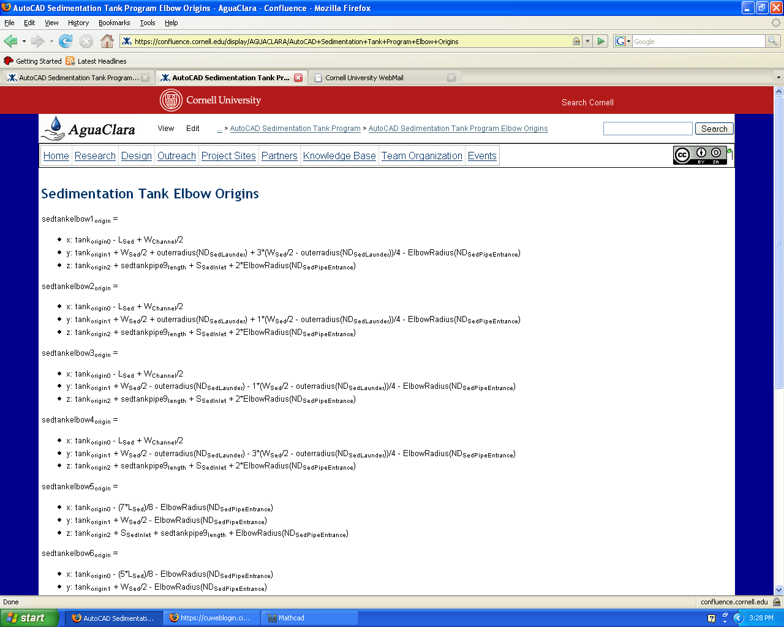
Sedimentation Tank – Elbow Origins

Slide 15
Work for Next Semester
Small Pages to be completed:
  Manifold
  Lamina
  Platform
  Sedimentation Tank Slopes
Large Pages to be completed:
  Grit Chamber
  Flocculation Tank
  Plant Level Tank
  Sedimentation Tank (?)

